Slide 1
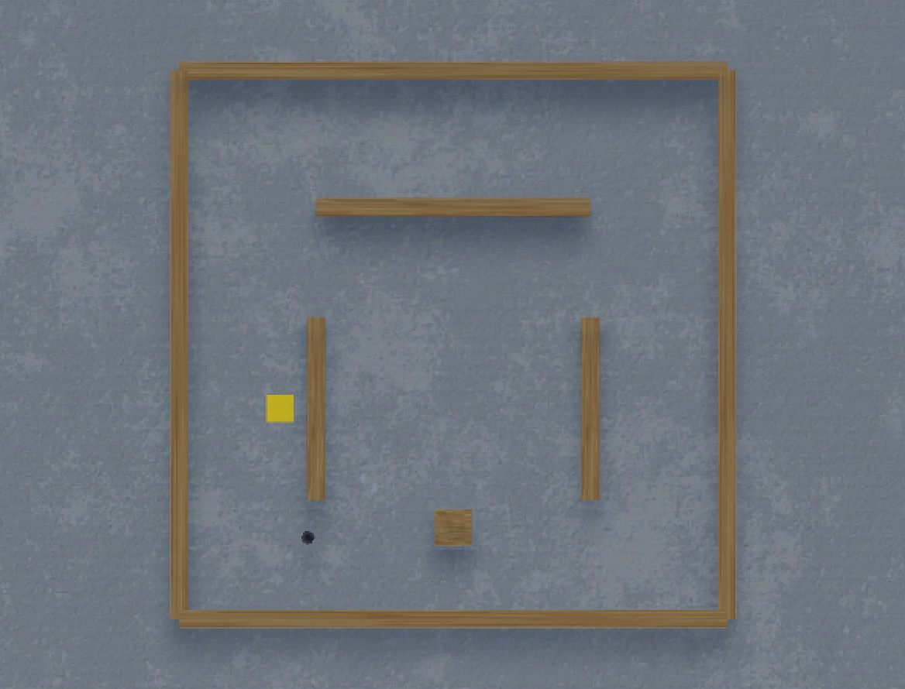
STD_20220530_093350_r125-1.5_TU-10/models/STD_id804_ep48601_srate98.h5

